Slide 1



Customer Churn Analysis
A Data Analytics Project

Slide 2







Introduction: Project Goals
Understand Behavior
Examine customer actions and patterns.
Identify Drivers
Pinpoint key factors leading to churn.
Actionable Insights
Data
Develop strategies for customer retention.
Understand the current situation
Insight
Make sense of data and highlight where to target action
Action
Move from data-driven insight to targeted action to deliver impactful change

Slide 3
Workflow Overview
Our analysis is consolidated within a single notebook: my_script.ipynb.
01
02
03
04
05
Data Understanding
Data Cleaning
Exploratory Analysis
Customer Segmentation
Advanced Analysis

Slide 4

Data Understanding & Cleaning
Initial Assessment
Refinement Process
Checked data structure
Cleaned inconsistencies
Identified missing values
Standardized formats
Verified data types
Validated dataset integrity

Slide 5
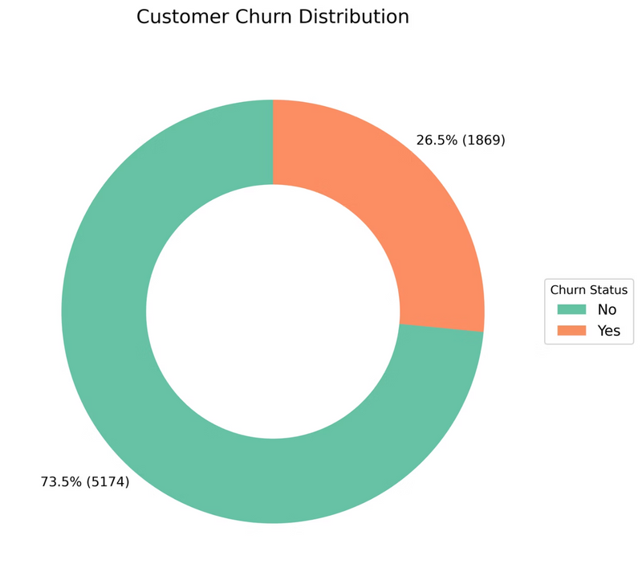
Exploratory Data Analysis (EDA)
Key Metrics
Churn Balance
Customer Demographics: Gender, age groups, senior citizen status
Assessed the balance of churned vs. non-churned customers.
Tenure Insights: Distribution of customer lifecycles (short, medium, long-term)
Revenue Drivers: Monthly and total charges trends
Churn Profile: Churn rate across segments and service types

Slide 6
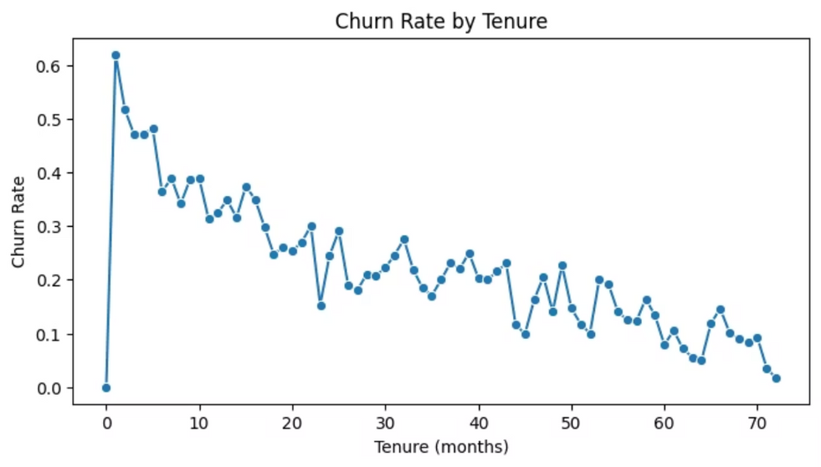
Customer Segmentation
Customers were segmented into tenure buckets to analyze spending patterns.
Short-Term
0–12 months
Mid-Term
13–36 months
Long-Term
37+ months

Slide 7
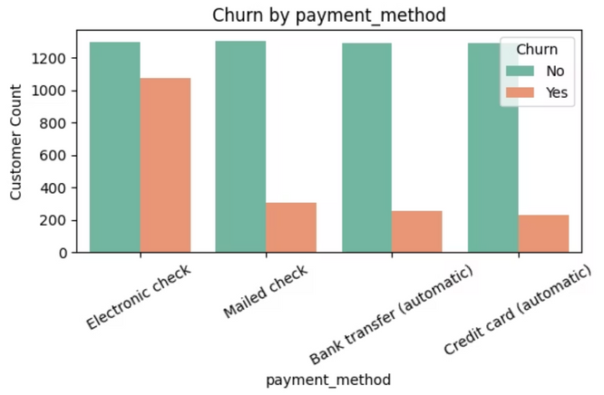
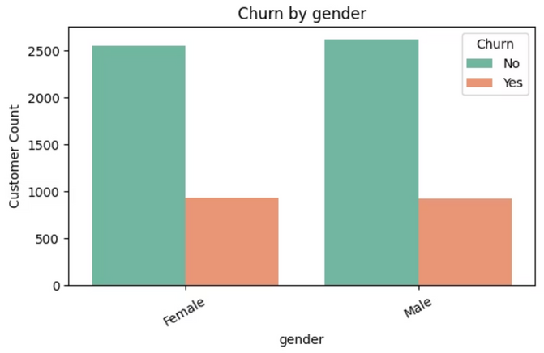
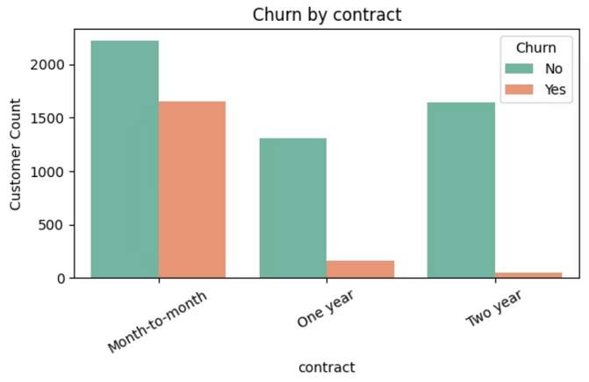
Advanced Analysis: Demographics
Churn rates were analyzed across various demographic and service-related factors.
Customer Demographics: Gender, age groups, senior citizen status
Tenure Insights: Distribution of customer lifecycles (short, medium, long-term)
Revenue Drivers: Monthly and total charges trends
Churn Profile: Churn rate across segments and service types

Slide 8
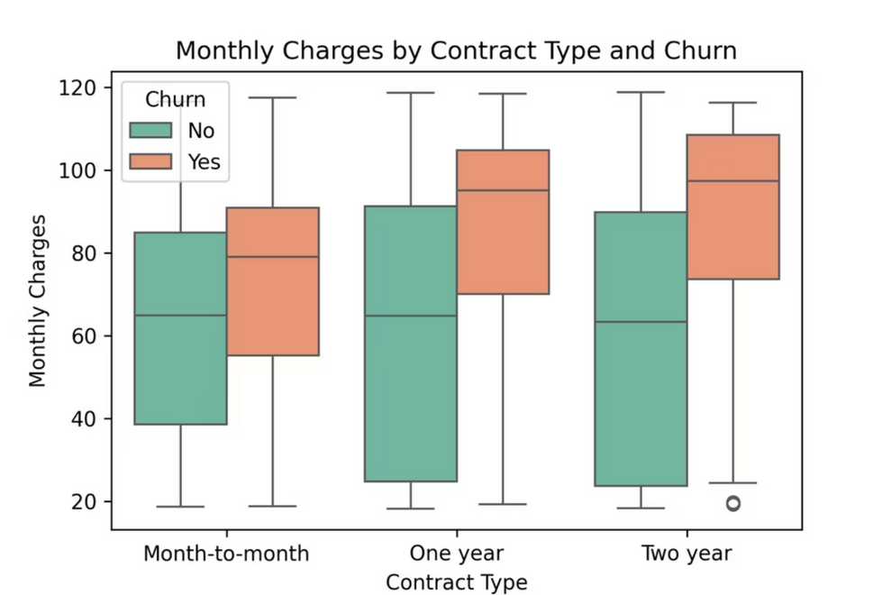
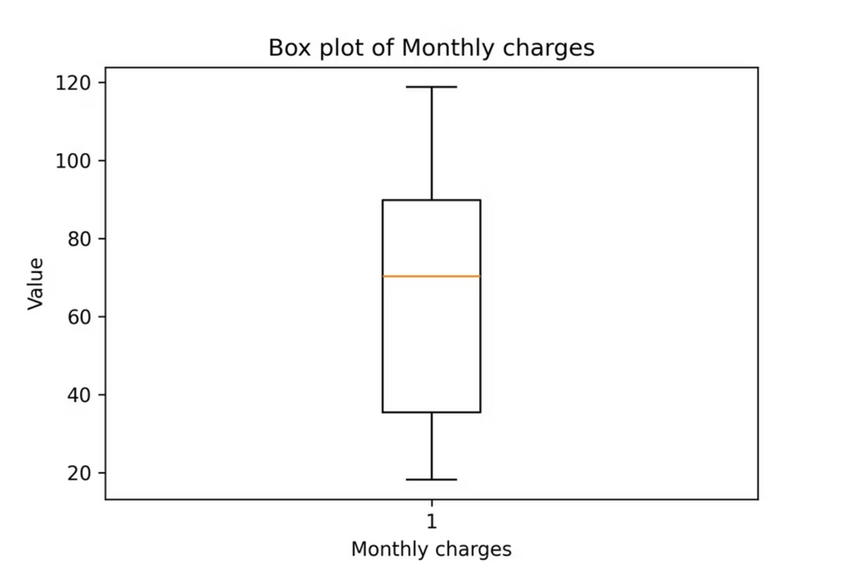
Advanced Analysis: Spending & Contracts
Contract types and monthly charges significantly impact churn.
Contract Influence
Spending Sensitivity
Compared churn across different contract types.
Analyzed churn based on monthly charges.
Identified contracts with higher churn rates.
Boxplots illustrate charge distribution vs. churn.

Slide 9

Customer Churn Insights
Leveraging data analytics to uncover critical customer behaviors, quantify retention performance, and formulate targeted strategies to reduce churn.
Customer Base Overview
Key Churn Patterns
Churn Rate: 26.5% overall (1,869 churned out of 7,043 customers).
New customer vulnerability: 40–60% churn in first 10 months, stabilizing after 20+ months
Revenue Distribution: Majority of customers contribute low revenue, while a small high-value segment drives disproportionate revenue impact.
Service gaps: Customers lacking device protection show 78% higher churn rates
Technology impact: Fiber customers demonstrate elevated churn compared to DSL users
Customer Support: Slow response times and unresolved issues.
Revenue Insights
Monthly charges range $18–120; median $65–70.
Lifetime revenue is extremely right-skewed (majority low, few high).
Top 1% customers generate ~$8,000+ total charges, crucial to overall revenue.

